Slide 1

Campus Placement Prediction

Slide 2
Objective:
The main objective of this PowerPoint presentation is to provide an in-depth analysis of the campus placement dataset and the results obtained from the predictive models. The presentation aims to deliver insights into the factors that influence campus placements, the accuracy of the models, and the potential impact on students' career decisions. It will be used to communicate the findings to stakeholders, including educational institutions, students, and placement officers.
Benefits:
Enhanced Decision Making
Time and cost saving
Improved placement outcome
Talent acquisition

Slide 3
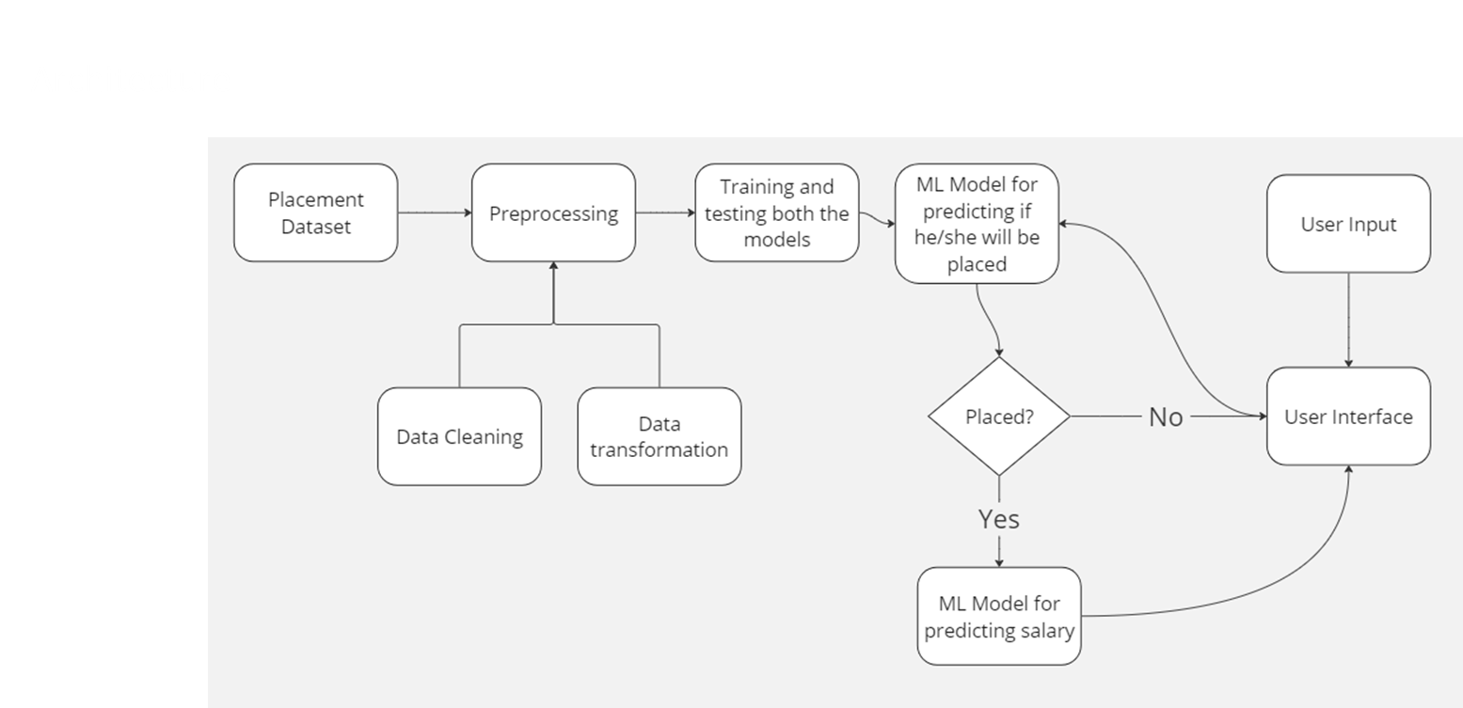

Slide 4
Data Validation and Data Transformation
Data Cleaning: Remove or correct any errors, inconsistencies, or missing values in the dataset to ensure data quality.
Feature Scaling: Scale numerical features to a common range (e.g., normalization or standardization) to prevent bias towards certain features during modeling.
Encoding Categorical Variables: Convert categorical variables into numerical form using techniques like one-hot encoding or label encoding.
Feature Engineering: Create new features or extract useful information from existing features to improve model performance.
Dimensionality Reduction: Use techniques like Principal Component Analysis (PCA) to reduce the number of features while preserving important information.
Handling Outliers: Identify and handle outliers in the data to avoid them from adversely affecting model performance.
Data Splitting: Divide the dataset into training, validation, and testing sets to train and evaluate the model effectively.

Slide 5
Model Training
Data Preprocessing
Performing EDA to get insight of data like identifying distribution , outliers ,trend
among data etc.
Check for null values in the columns. If present impute the null values.
Encode the categorical values with numeric values.
Perform Standard Scalar to scale down the values.

Slide 6
Prediction
Used Logistic regression and SVM for predicting if placed or not. Then using linear regression to predict salary.
Used threshold selection for logistic regressing to boost accuracy score
Also tested various other models.
Model was tested on test dataset and various metrics were evaluated
The best accuracy score was found in logistic regression

Slide 7
Q & A:
Q1) What’s the source of data?
https://www.kaggle.com/c/ml-with-python-course-project/data
Q 2) What was the type of data?
The data was the combination of numerical and Categorical values.
Q 3) What’s the complete flow you followed in this Project?
Refer slide 3 for better Understanding

Slide 8
Q 6) What techniques were you using for data pre-processing?
Removing unwanted attributes
Visualizing relation of independent variables with each other and output variables
Removing outliers
Cleaning data and imputing if null values are present.
Converting categorical data into numeric values.
Scaling the data

Slide 9
Q 7) How training was done or what models were used?
Before diving the data in training and validation set we performed clustering over fit to divide the data into clusters.
The scaling was performed over training and validation data

